Slide 1
Course Information
Course Instructor: Prof. Ryan Murelli
Office: 437 New Ingersoll
Email: rpmurelli@brooklyn.cuny.edu
Office Hours: Tues 11-12:00, Thurs 11-12:00
Phone: 718-951-5000 x2821
If I don’t answer, email me (don’t leave voicemail)
Syllabus can be found at:
http://chemscript.brooklyn.cuny.edu/web/Course_homepages.php
Or go to chem department website and click “course homepages” link
Or simply Google Search “Murelli” or “Murelli Course”

Slide 2
Your Obligations
Come to every class and recitation on time and prepared
I reserve the right to throw out anyone who shows up late
Study hard and smart outside of class (>10 hours/week))
Spend 2-3 hours minimum reading and understanding concepts
Spend 7-8 hours minimum practicing problems
Study in groups so that you can get feedback
Be ethical in your approach to the course. Be honest with yourself and your instructors and don’t try to take shortcuts to get better grades
Make no excuses
This is your class, and it is your responsibility to do what it takes to succeed in this class.

Slide 3
Grading
I anticipate a final course average of ~C-C+.
There is no true curve. But historically:
<45 overall average – F
45-60 – C range
60-80 – B range
>80 – A Range
Exam averages are typically 50-60 (70%)
Quiz averages are typically higher (70) (25%)
I reserve the right, based on my own judgement, to set the final grades any way I see fit. This will be primarily based upon my assessment of different “tier’s” likely success in Organic II.

Slide 4
Quizzes (25% of Grade)
First Quiz is in less then 2 weeks! (2/12-2/20)
Quizzes are usually 30 minutes long and start 5 minutes into the class..
show up early on quiz days!
Lowest Quiz grade will be dropped
This is to account for a bad day, which can be mental, transportation, or health related.
No makeup quizzes are allowed.
If you anticipate missing a quiz for any reason, you can request to take it at another recitation section in advance (requests within 24 hours of your quiz will not be granted)
Notes:
For quizzes, any topic covered in class before the quiz is fair game.

Slide 5
EXAMS
Mid Terms
Exam 1 (3/13)
Exam 2 (5/1)
Final Exam (5/24)
General structure I shoot for
20% Easy
60% Moderate (Quiz Level Difficulty +)
20% Very Challenging

Slide 6
What is Organic Chemistry?
Notes:
Start the class by asking students to define organic chemistry. Set a tone of “you better stay awake in this class”

Slide 7
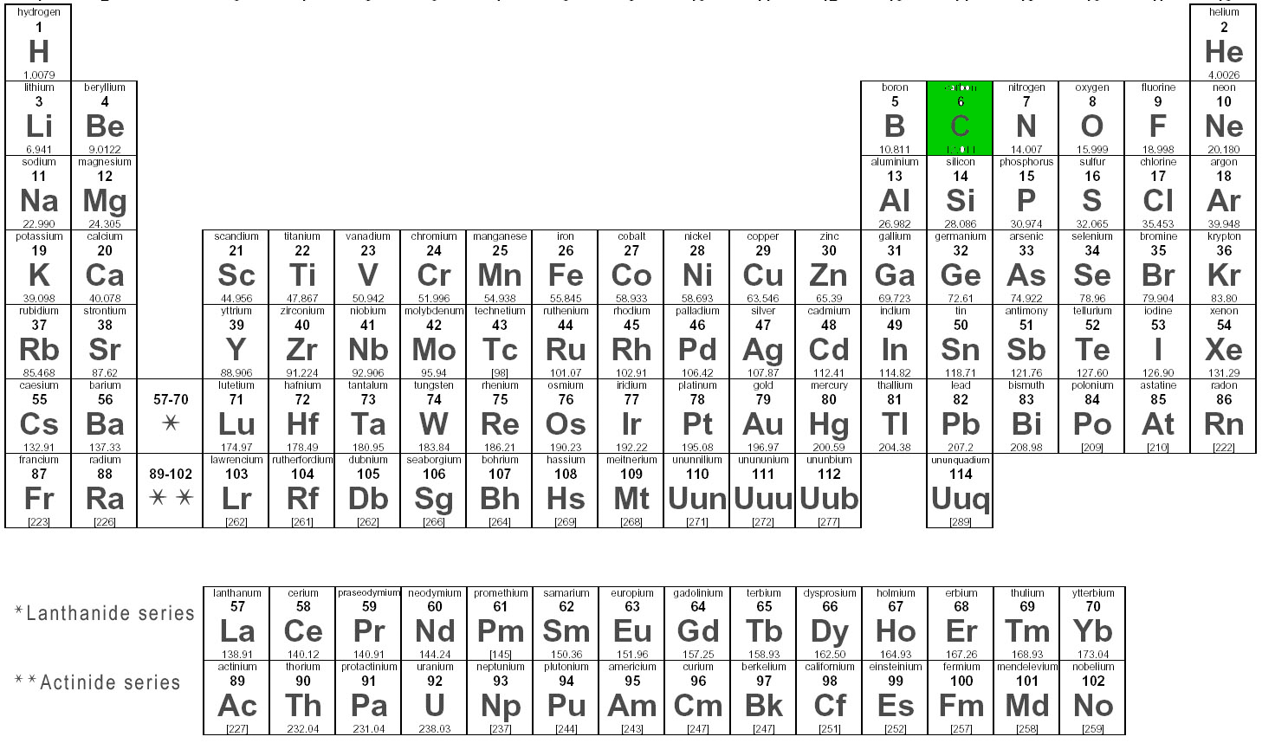
Introduction to Organic Chemistry
Organic Chemistry is the study of carbon-containing compounds.
Notes:
Organic Chemistry is the study of carbon-containing molecules. Why do we care enough about one element in the periodic table to spend two semesters studying for it?

Slide 8
Introduction to Organic Chemistry
Organic Chemistry is the study of carbon-containing compounds.
The overwhelming majority of the building blocks of life are made up of carbon containing compounds.
Notes:
The overwhelming majority of life’s bulding blocks are made up of carbon. For example here are 3 essential building blocks of human life. And more-so, carbon is the backbone. It provides the framework for many important molecules

Slide 9
Introduction to Organic Chemistry
Organic Chemistry is the study of carbon-containing compounds.
The overwhelming majority of the building blocks of life are made up of carbon containing compounds.
As are the vast majority of therapeutics
Notes:
Here are 3 of the biggest money-making drugs on the market today. Asprin (anti-inflammatory), Lipitor (Cholesterol lowering), and Plavix (platelet aggregation inhibitor used to treat or prevent several diseases including heart disease)

Slide 10
What is an Organic Chemist?
Organic chemists are able to talk and think at the molecular level
Organic Chemists have a good understanding of the reactivity of different organic molecules and predict stability of them in different environments
Organic chemists are able to use several different “spectroscopic techniques” to solve molecular structures or learn different things about their properties.
Many organic chemists (often called synthetic organic chemists) are able to create new molecules in the lab from simpler cheaper building blocks for various purposes

Slide 11
Many other fields of chemistry have similar skill sets that are first learned in Organic Chemistry I
Organic Chemists
Small Organic Molecules
Chemical Biologists
Organometallic Chemists
Biological Chemists
Biological macromolecules
(ie Enzymes, Proteins, DNA/RNA)
Inorganic Chemists
Carbon-free molecules
Bioinorganic Chemists

Slide 12
Some Examples of Jobs for People with Strong Organic Chemistry Backgrounds
Medicinal Chemists
Design and synthesize molecules for therapeutic applications
Process Chemist
Come up with methods to make syntheses more efficient
Material Scientist
Design molecules, often polymers, with favorable material properties
Patent Lawyers
Work to protect intellectual property, often in pharmaceutical industry
Environmental Chemists
Monitory and analyze effects of natural and manmade organic materials in the environment

Slide 13
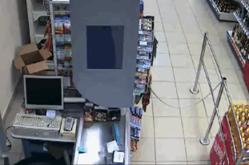
Why do students struggle?
Many New, Necessary Skills
Drawing molecules “the organic chemistry way”
Perceiving 3-dimensional structures in 2-dimensions
Drawing and thinking about reactions with arrows
New language with new words and phrases
Drawing Organic Molecules in Different Ways
Drawing Reaction Mechanisms
Learning New Reactions
Master Synthesis
Get A!
Students trip up along the way and…
Notes:
So why is organic chemistry a class that many students struggle with? Well here is an example of a question that could show up on your final. First, aside from those of you who may be retaking the class or have had prior exposure to organic chemistry, by a show of hands how many people understand what this question is asking?

Slide 14
Things you should already know
Electronegativity
When there is a bond between two atoms, which atom will pull on the electrons more?
Valence Electrons
When an element has a certain electron count, what is its charge?
Why does O, N, C want to have 8 total electrons, but H only 2?
Molecular Orbitals
What do s and p orbitals look like?
What are bonding and antibonding orbitals?
What are sigma bonds and pi bonds?
Lewis Structures
Can you draw a molecule in Lewis structure format appropriately?
If you can not answer these questions easily, you need to review IMMEDIATELY

